Slide 1
Graph Theory - Introduction
Lesson 3a

Slide 2
Graphs: The Basics
A graph is a pair of sets of vertices and edges.
A vertex or node represents objects of interest in a given study.
An edge represents a relationship between two vertices. This relationship is defined by the nature of the study.
Examples
The internet: webpages are represented as nodes and the hyperlinks between those sites are represented as edges.
Social Networks: each person is represented as a vertex, and the edges could represent the friendships between the individuals.

Slide 3
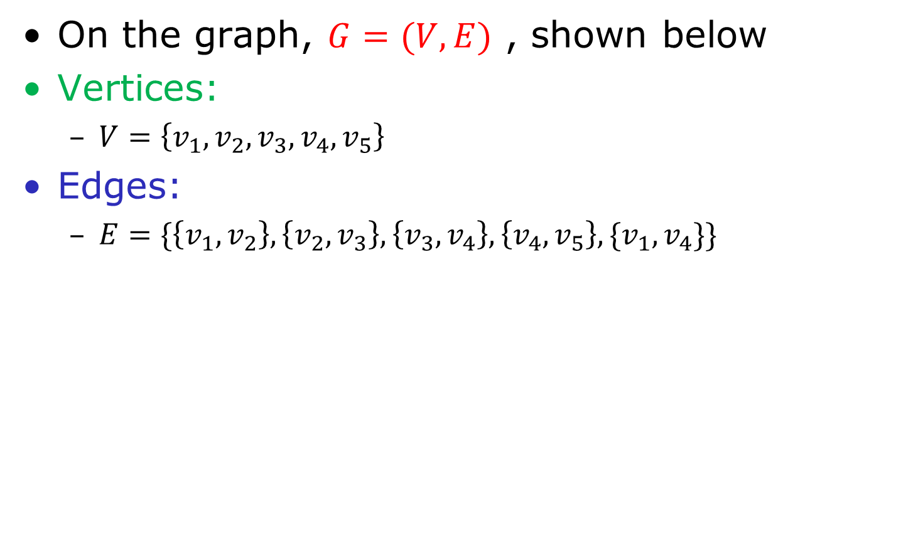
Graphs: The Basics
On the graph, $G=(V,E)$ , shown below
Vertices:
$V=\left\{v_{1},v_{2},v_{3},v_{4},v_{5}\right\}$
Edges:
$E=\{\left\{v_{1},v_{2}\right\},\left\{v_{2},v_{3}\right\},\left\{v_{3},v_{4}\right\},\left\{v_{4},v_{5}\right\},\{v_{1},v_{4}\}\}$

Slide 4
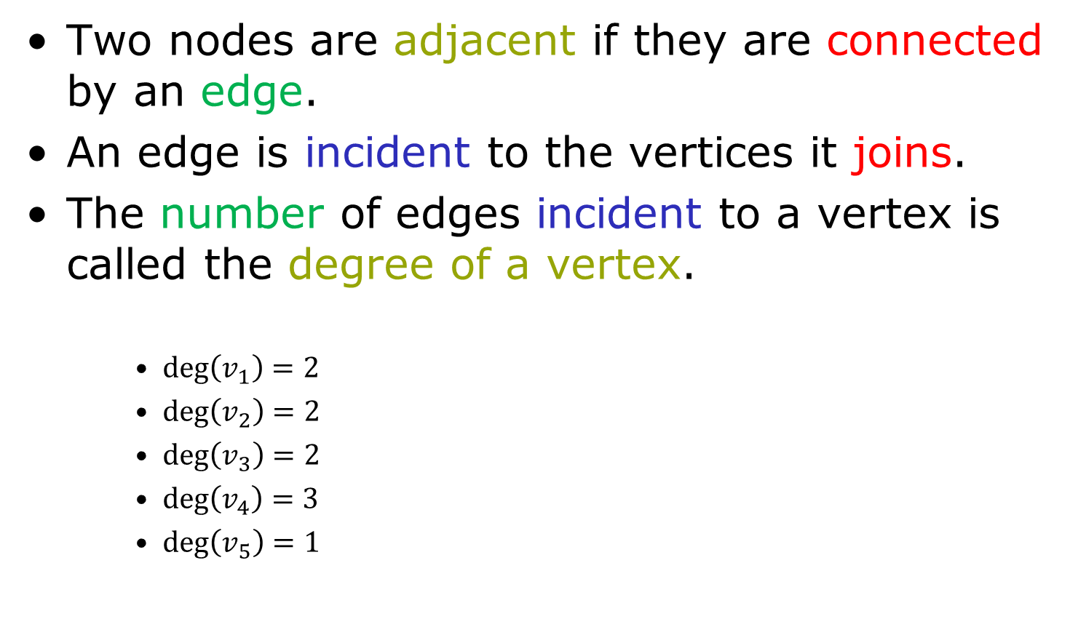
Graphs: The Basics
Two nodes are adjacent if they are connected by an edge.
An edge is incident to the vertices it joins.
The number of edges incident to a vertex is called the degree of a vertex.
$\deg\left(v_{1}\right)=2$
$\deg\left(v_{2}\right)=2$
$\deg\left(v_{3}\right)=2$
$\deg\left(v_{4}\right)=3$
$\deg\left(v_{5}\right)=1$

Slide 5








Common Graphs
$$v_{4}$$
Complete Graph
There is an edge for every two vertices
Empty Graph
There is no edges between vertices
$$v_{1}$$
$$v_{2}$$
$$v_{3}$$
$$v_{4}$$
$$v_{1}$$
$$v_{2}$$
$$v_{3}$$

Slide 6








Common Graphs
Line Graph
Edges are in sequence
Cyclic Graph
Line graph that stars and ends at the same vertex.
$$v_{4}$$
$$v_{1}$$
$$v_{2}$$
$$v_{3}$$
$$v_{4}$$
$$v_{1}$$
$$v_{2}$$
$$v_{3}$$

Slide 7



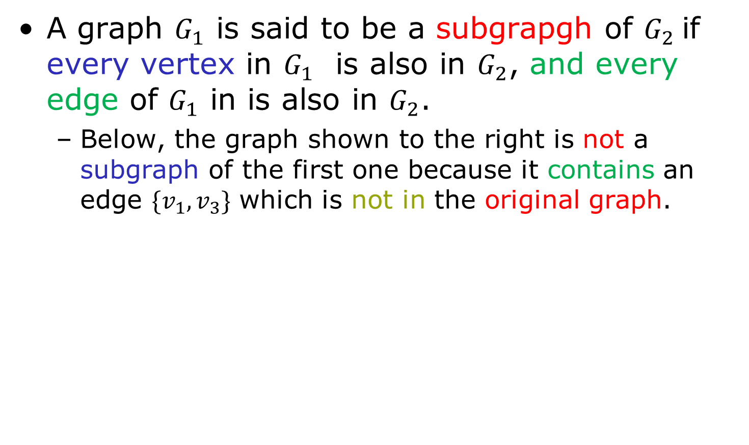



Subgraphs
A graph $G_{1}$ is said to be a subgrapgh of $G_{2}$if every vertex in $G_{1}$ is also in $G_{2}$, and every edge of $G_{1}$ in is also in $G_{2}$.
Below, the graph shown to the right is not a subgraph of the first one because it contains an edge $\{v_{1},v_{3}\}$ which is not in the original graph.
$$v_{4}$$
$$v_{4}$$
$$v_{4}$$
$$v_{1}$$
$$v_{1}$$
$$v_{2}$$
$$v_{2}$$
$$v_{2}$$
$$v_{3}$$
$$v_{3}$$
$$v_{3}$$
Graph $G=(V,E)$ | Subgrapgh of $G$ | Not a subgraph of $G$

Slide 8




Weighted Graphs
A weighted graph has the same characteristics of a simple graph. Only in this case each edge is associated with a real number that specifies how strong a relationship between edges is.
$$v_{4}$$
a`
$$v_{1}$$
c`
b`
a`
$$v_{2}$$
c`
$$v_{3}$$

